Slide 1

User Interaction and Intuitive Navigation
Android Developer Fundamentals
Lesson 4
This work is licensed under a Creative Commons Attribution-NonCommercial 4.0 International License
Android Developer Fundamentals

Slide 2
4.3 Screen Navigation
This work is licensed under a Creative Commons Attribution-NonCommercial 4.0 International License

Slide 3
Contents
Back navigation
Hierarchical navigation
Up navigation
Descendant navigation
Navigation drawer for descendant navigation
Lists and carousels for descendant navigation
Ancestral navigation
Lateral navigation

Slide 4


Two forms of navigation
Temporal or back navigation
provided by the device's back button
controlled by the Android system's back stack
Ancestral or up navigation
provided by the app's action bar
controlled by defining parent-child relationships between activities in the Android manifest
Notes:
Up is left

Slide 5
Back Navigation

Slide 6
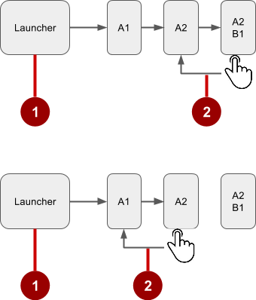
Navigation through history of screens
Historys starts from Launcher
User clicks the Back button to navigate to the previous screens in reverse order

Slide 7
Changing Back button behavior
Android system manages the back stack and Back button
If in doubt, don't change
Only override, if necessary to satisfy user expectation
For example: In an embedded browser, trigger browser's default back behavior when user presses device Back button

Slide 8
Overriding onBackPressed()
@Override
public void onBackPressed() {
// Add the Back key handler here.
return;
}

Slide 9
Hierarchical Navigation

Slide 10
Hierarchical navigation patterns
Parent screen—Screen that enables navigation down to child screens, such as home screen and main activity
Collection sibling—Screen enabling navigation to a collection of child screens, such as a list of headlines
Section sibling—Screen with content, such as a story

Slide 11
Example of a screen hierarchy
Parent screen
Children: collection siblings
Children: section siblings
Use activities or fragments to implement a hierarchy
1
News App
2
Top Stories
Tech News
Cooking
Headline
Headline
Headline
Headline
Headline
Headline
Headline
Headline
Headline
Headline
Headline
Headline
3
Story
Story
Story

Slide 12
Types of hierarchical navigation
Descendant navigation
Down from a parent screen to one of its children
From a list of headlines to a story summary to a story
Ancestral navigation
Up from a child or sibling screen to its parent
From a story summary back to the headlines
Lateral navigation
From one sibling to another sibling
Swiping between tabbed views

Slide 13
Descendant Navigation

Slide 14
Descendant navigation
Descendant navigation
Down from a parent screen to one of its children
From the main screen to a list of headlines to a story
News App
Top Stories
Tech News
Cooking
Headline
Headline
Headline
Headline
Headline
Headline
Headline
Headline
Headline
Headline
Headline
Headline
Story
Story
Story

Slide 15
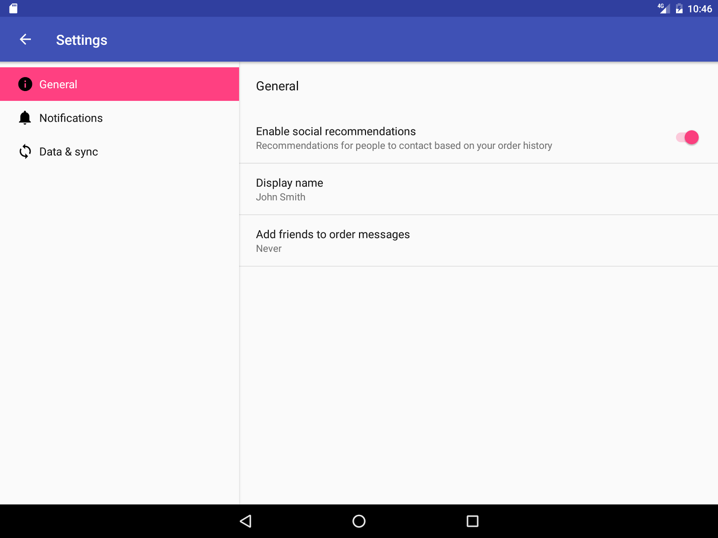
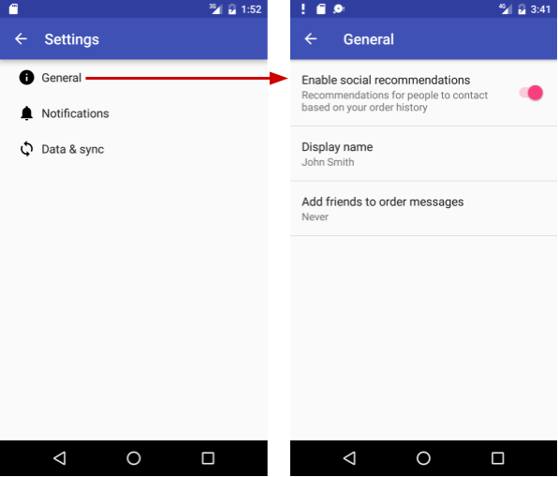
Master/detail flow
Side-by side on tablets
Multiple screens on phone

Slide 16
Controls for descendant navigation
Buttons, image buttons on main screen
Other clickable views with text and icons
Arranged in horizontal or vertical rows, or as a grid
List items on collection screens

Slide 17
Navigation Drawer for Descendant Navigation

Slide 18
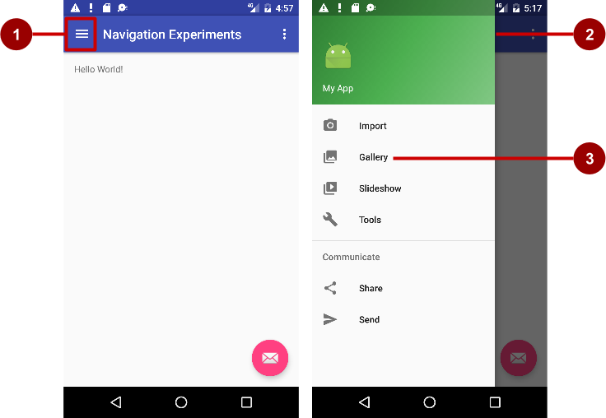
Navigation drawer
Icon in app bar
Header
Menu items

Slide 19
Steps for navigation drawer
Create layouts for drawer, drawer header, drawer menu items, app bar, activity screen contents
Add navigation drawer and item listeners to activity code
Handle the navigation drawer menu item selections

Slide 20
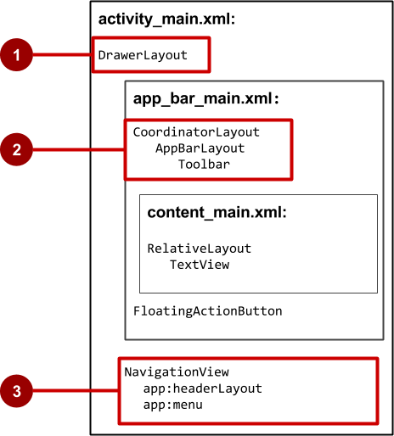
Navigation drawer activity layout
DrawerLayout is root view
CoordinatorLayout contains app bar layout with a Toolbar
App content screen layout
NavigationView with layouts for header and selectable items
3
4

Slide 21
Other descendant navigation patterns
Vertical list, such as RecyclerView
Vertical grid, such as GridView
Lateral navigation with a Carousel
Multi-level menus, such as the Options menu
Master/detail navigation flow

Slide 22
Ancestral Navigation

Slide 23
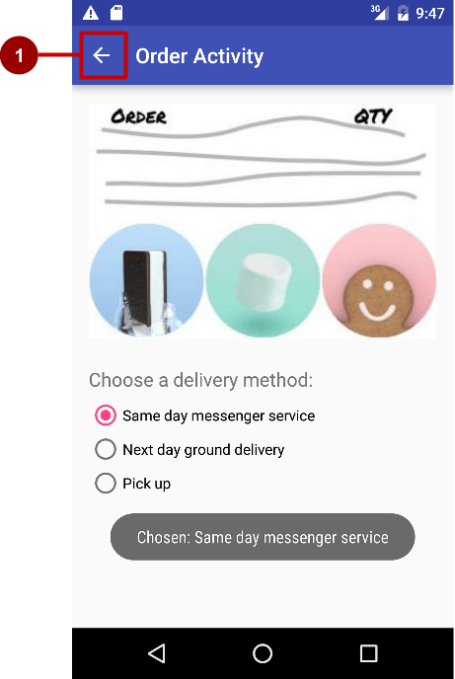
Ancestral navigation (Up button)
Enable user to go up from a section or child screen to the parent

Slide 24
Declare activity’s parent in Android manifest
<activity android:name=".OrderActivity"
android:label="@string/title_activity_order"
android:parentActivityName="com.example.android.
optionsmenuorderactivity.MainActivity">
<meta-data
android:name="android.support.PARENT_ACTIVITY"
android:value=".MainActivity"/>
</activity>

Slide 25
Lateral Navigation

Slide 26
Tabs and swipes
Lateral navigation
Between siblings
From a list of stories to a list in a different tab
From story to story under the same tab
News App
Top Stories
Tech News
Cooking
Headline
Headline
Headline
Headline
Headline
Headline
Headline
Headline
Headline
Headline
Headline
Headline
Story
Story
Story

Slide 27
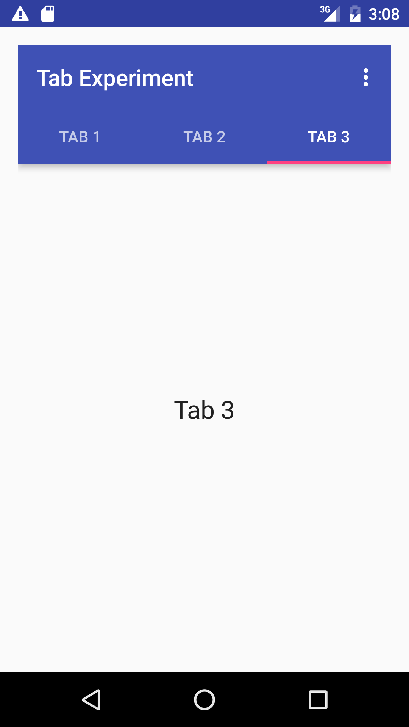
Benefits of using tabs and swipes
A single, initially-selected tab—users have access to content without further navigation
Navigate between related screens without visiting parent

Slide 28
Best practices with tabs
Lay out horizontally
Run along top of screen
Persistent across related screens
Switching should not be treated as history

Slide 29
Steps for implementing tabs
Define the tab layout using TabLayout
Implement a fragment and its layout for each tab
Implement a PagerAdapter from FragmentPagerAdapter or FragmentStatePagerAdapter
Create an instance of the tab layout
Manage screen views in fragments
Set a listener to determine which tab is tapped
See Practical for coding details; summary in following slides

Slide 30
Add tab layout below Toolbar
<android.support.design.widget.TabLayout
android:id="@+id/tab_layout"
android:layout_width="match_parent"
android:layout_height="wrap_content"
android:layout_below="@id/toolbar"
android:background="?attr/colorPrimary"
android:minHeight="?attr/actionBarSize"
android:theme="@style/ThemeOverlay.AppCompat.Dark.ActionBar"/>

Slide 31
Add view pager below TabLayout
<android.support.v4.view.ViewPager
android:id="@+id/pager"
android:layout_width="match_parent"
android:layout_height="fill_parent"
android:layout_below="@id/tab_layout" />

Slide 32
Create a tab layout in onCreate()
TabLayout tabLayout = (TabLayout) findViewById(R.id.tab_layout);
tabLayout.addTab(tabLayout.newTab().setText("Tab 1"));
tabLayout.addTab(tabLayout.newTab().setText("Tab 2"));
tabLayout.addTab(tabLayout.newTab().setText("Tab 3"));
tabLayout.setTabGravity(TabLayout.GRAVITY_FILL);

Slide 33
Add the view pager in onCreate()
final ViewPager viewPager = (ViewPager) findViewById(R.id.pager);
final PagerAdapter adapter = new PagerAdapter (
getSupportFragmentManager(), tabLayout.getTabCount());
viewPager.setAdapter(adapter);

Slide 34
Add the listener in onCreate()
viewPager.addOnPageChangeListener(
new TabLayout.TabLayoutOnPageChangeListener(tabLayout));
tabLayout.addOnTabSelectedListener(
new TabLayout.OnTabSelectedListener() {
@Override
public void onTabSelected(TabLayout.Tab tab) { viewPager.setCurrentItem(tab.getPosition());}
@Override
public void onTabUnselected(TabLayout.Tab tab) {}
@Override
public void onTabReselected(TabLayout.Tab tab) {} });

Slide 35
Learn more
Navigation Design guide d.android.com/design/patterns/navigation.html
Designing effective navigation d.android.com/training/design-navigation/index.html
Creating a Navigation Drawer d.android.com/training/implementing-navigation/nav-drawer.html
Creating swipe views with tabs d.android.com/training/implementing-navigation/lateral.html

Slide 36
What's Next?
Concept Chapter: 4.3 C Screen Navigation
Practical: 4.3 P Using the App Bar and Tabs for Navigation

Slide 37
END

